Slide 1
Topic 4 Monitor Data to
Trigger Control from Cloud

Slide 2
IoT Communication Standards
IoT Architecture: The IoT Architecture provides a blueprint for the design and implementation of IoT systems. It deﬁnes the basic building blocks of an IoT system and the interfaces between them.
Security Guidelines: Security is a critical aspect of IoT systems, and there are various guidelines and best practices that can help ensure the security of IoT devices and networks. These guidelines include secure boot, secure communication, and device authentication.
Connectivity Standards: There are several connectivity standards for IoT, including Wi-Fi, Bluetooth, Zigbee, Z-Wave, LoRaWAN, Sigfox, and NB-IoT. Each of these standards has its own unique features and characteristics that make them suitable for different IoT applications.

Slide 3
IoT Communication Standards
Data Communication Standards: IoT devices generate large amounts of data, and there are various communication standards that can be used to transmit this data. These standards include MQTT, CoAP, REST, and WebSocket.
Interoperability Guidelines: Interoperability is important for IoT devices to work together seamlessly. There are several guidelines and standards that can help ensure interoperability, such as the Open Connectivity Foundation (OCF), the Zigbee Alliance, and the Thread Group.

Slide 4
IoT Communication Standards
Energy Efficiency Guidelines: IoT devices often operate on battery power or other low-power sources, which requires energy-efficient design and management. Guidelines for energy efficiency in IoT include minimizing power consumption, optimizing transmission schedules, and using low-power communication technologies.
Cloud Communication Standards: Cloud computing is an important aspect of many IoT systems, and there are various communication standards that can be used to transmit data between IoT devices and the cloud. These standards include HTTP, AMQP, and MQTT.
●

Slide 5
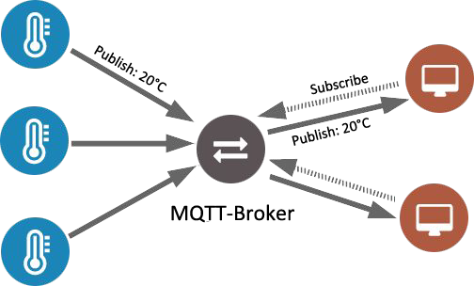
MQTT Standard
109

Slide 6
MQTT Standard
MQTT is a publish/subscribe architecture that is developed primarily to connect bandwidth and power-constrained devices over wireless networks.
It is a simple and lightweight protocol that runs over TCP/IP sockets or WebSockets. MQTT over WebSockets can be secured with SSL.
The publish/subscribe architecture enables messages to be pushed to the client devices without the device needing to continuously poll the server.
The MQTT broker is the central point of communication, and it is in charge of dispatching all messages between the senders and the rightful receivers.
A client is any device that connec¹t¹s⁰ to the broker and can publish or subscribe to topics to access the information. A topic contains the routing information for the broker.
Each client that wants to send messages publishes them to a certain topic, and each client that wants to receive messages subscribes to a certain topic.
The broker delivers all messages with the matching topic to the appropriate clients.
port 1883port

Slide 7
Key Features of MQTT
Pub/Sub Model: MQTT uses a publish/subscribe (pub/sub) messaging model, where devices can publish messages to a topic, and other devices can subscribe to that topic to receive those messages.
QoS Levels: MQTT supports three different quality of service (QoS) levels: 0, 1, and 2. QoS 0 delivers messages with no guarantee of delivery, while QoS 1 and QoS 2 provide increasing levels of reliability.
Lightweight: MQTT is desi11g1 ned to be lightweight and efficient, which makes it suitable for use in resource-constrained devices, such as sensors and microcontrollers. The protocol header is only 2 bytes long, and messages can be as small as a single byte

Slide 8
Key Features of MQTT
TCP/IP Based: MQTT uses TCP/IP as its underlying transport protocol, which provides reliable, connection-oriented communication between devices.
Last Will and Testament: MQTT provides a Last Will and Testament (LWT) feature, which allows devices to specify a message that will be sent to a topic if the device unexpectedly disconnects from the
network.
112
Retained Messages: MQTT supports retained messages, which are messages that are stored on the MQTT broker and sent to any new subscribers that connect to the topic.
Security: MQTT provides security features, such as authentication and encryption, to protect the privacy and integrity of IoT data.

Slide 9

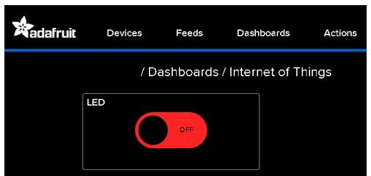
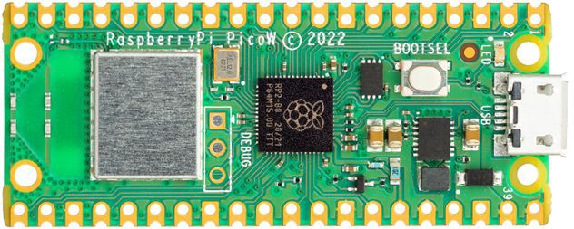



Read Data from the Cloud
To read data from the cloud, we could use either HTTP API or MQTT API.
To achieve this with Adafruit.io, we will create a new Micropython code.
This will allow us to control the Raspberry Pi Pico W on-board LED using the cloud toggle switch.
113

Slide 10

Create Adafruit.io Feed
Follow the previous steps of creating a feed.
After clicking on “New Feeds”, you will be prompted to give the new feed a name and description (optional).
Once done, click the “Create” button.

Slide 11

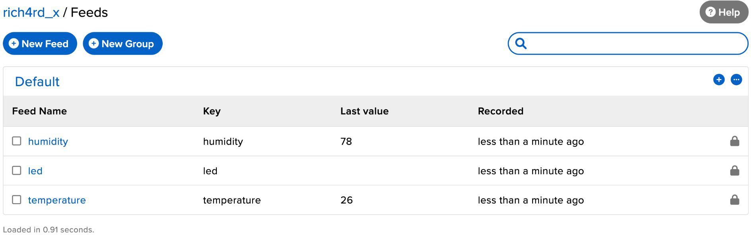
Completed Adafruit.io Feed
Once you have created the led feed, it should look like this.

Slide 12

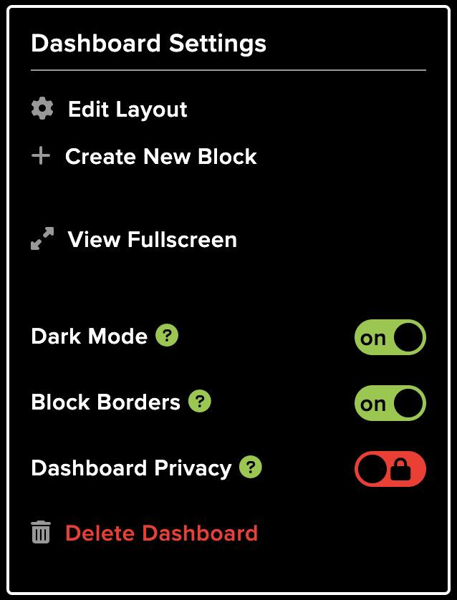
Setup Dashboard Blocks
On the existing dashboard, you will the previously created blocks.
We will create one more block that will be used to control the in-built LED on the Raspberry Pi Pico W.
Click on the settings dropdown icon and click “Create New Block”.

Slide 13
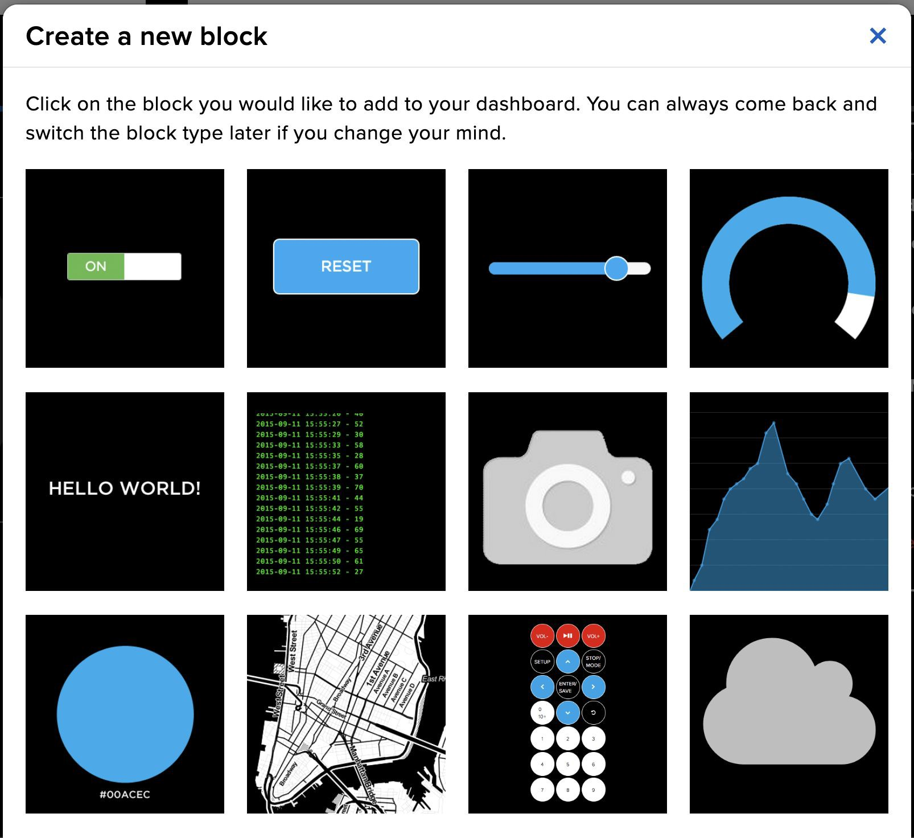
Setup Dashboard Blocks
From the various options to choose from, choose the toggle block.
Select the ‘led’ feed and click “Next step”.

Slide 14
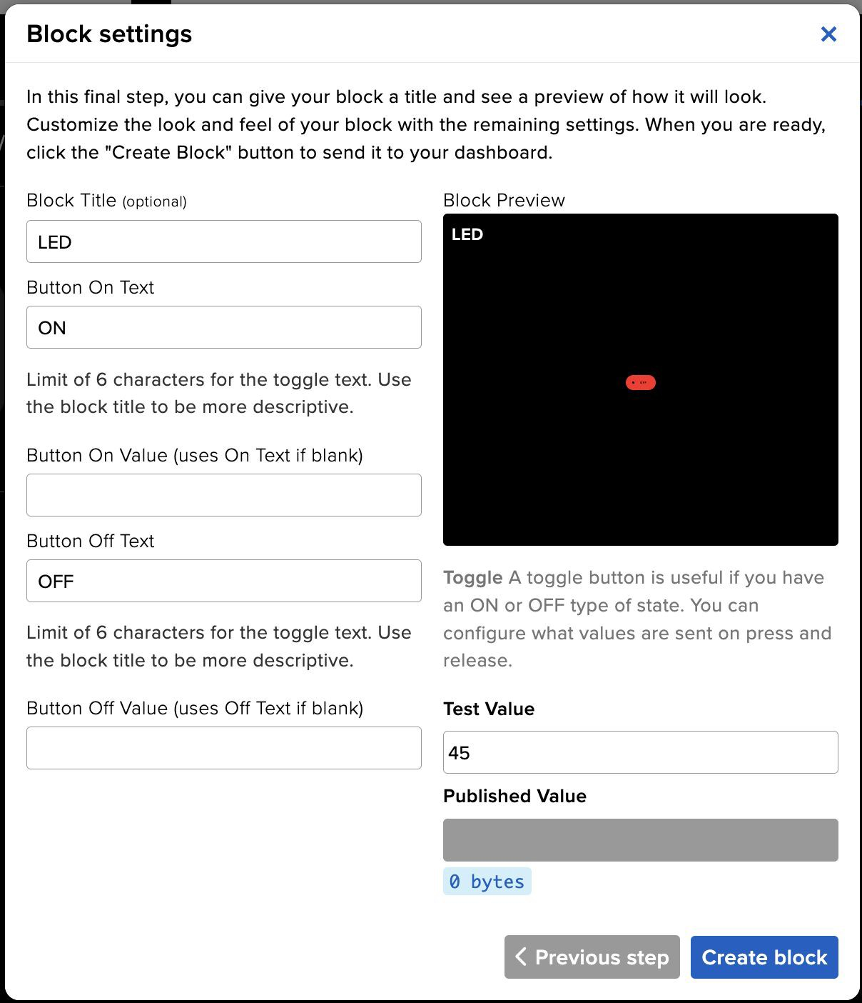
Setup LED Block
Under the Block settings, setup the block as shown for the
led toggle block:
Block Title (optional)
Once done, click “Create Block”.

Slide 15
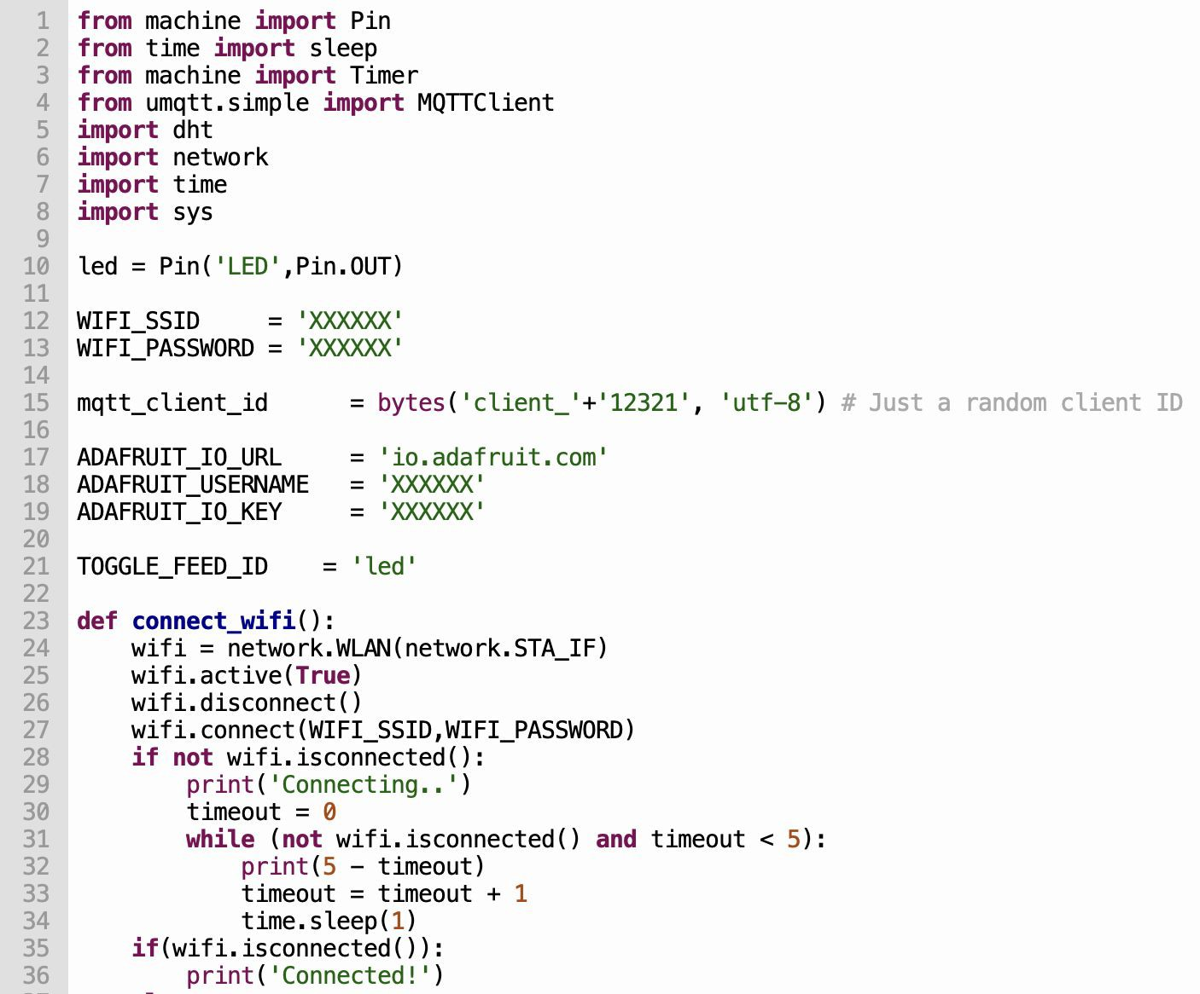
Control Device via IoT
To control the Raspberry Pi Pico W from the cloud - Control LED

Slide 16
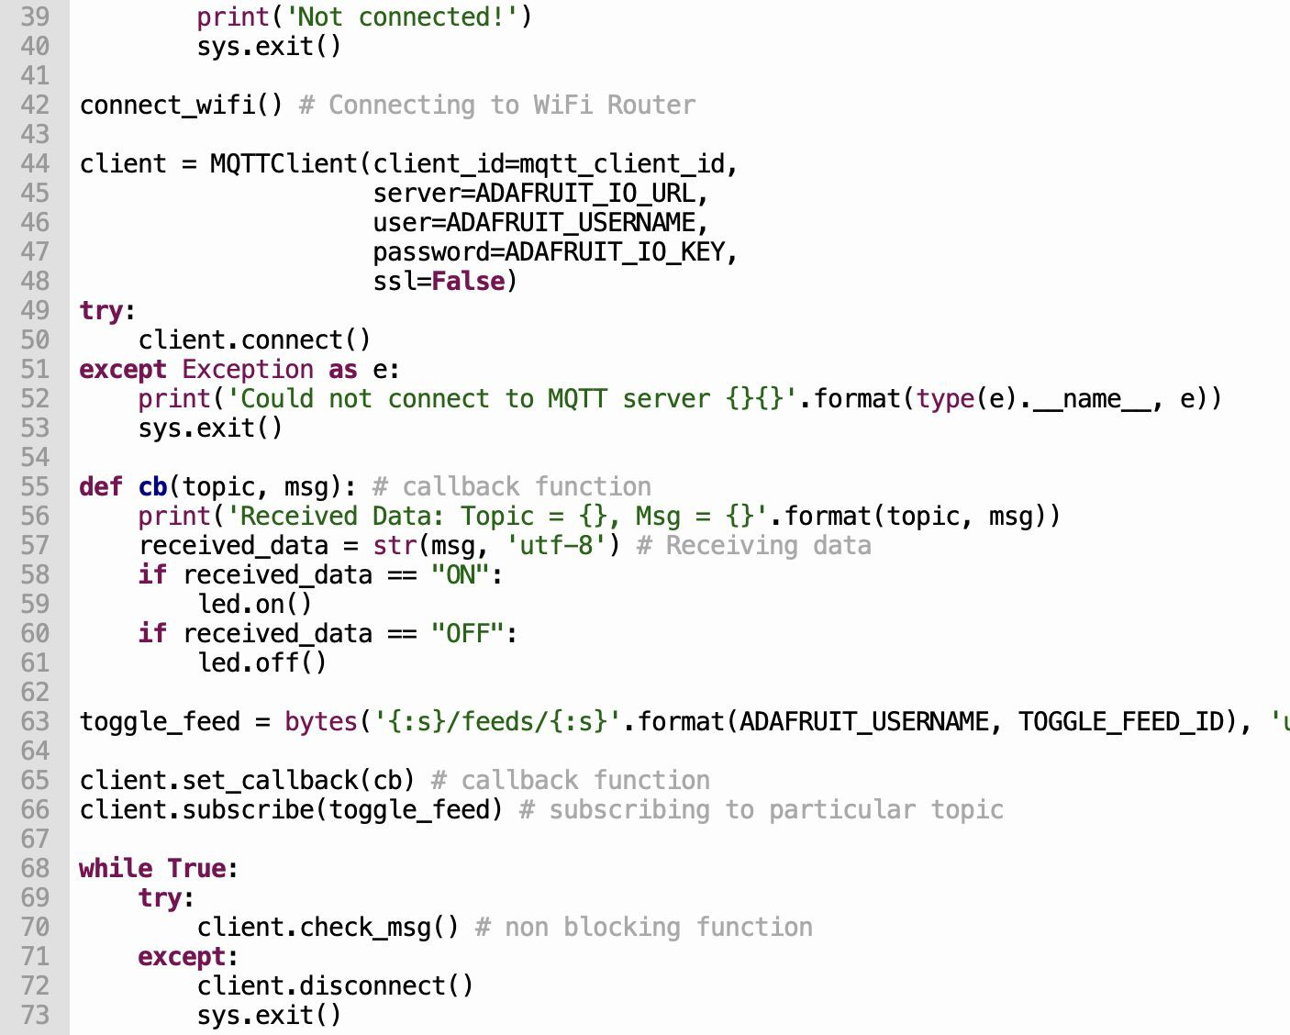
Control Device via IoT
To control the Raspberry Pi Pico W from the cloud - Control LED

Slide 17
Activity: Control Device from Cloud
Time to apply what you have learnt.
Control the Raspberry Pi Pico W LED.
Setup LED to 1 if the humidity is more than 80, else set the LED to 0.\
You can download the file conect2cloud.py from the GITHUB
https://github.com/NYP-RoboticsSG/IOT

Slide 18

What is IoT Security?
While traditional information cybersecurity revolves around software and how it is implemented, security for IoT adds an extra layer of complexity as the cyber and the physical worlds converge.
A wide range of operational and maintenance scenarios in the IoT space rely on end-to-end device connectivity to enable users and services to interact, login, troubleshoot, send, or receive data from devices.
Knowing what IoT security standards to adhere to is essential, because operational technology (OT) is too important and valuable to risk in the event of breaches, disasters, and other threats.

Slide 19
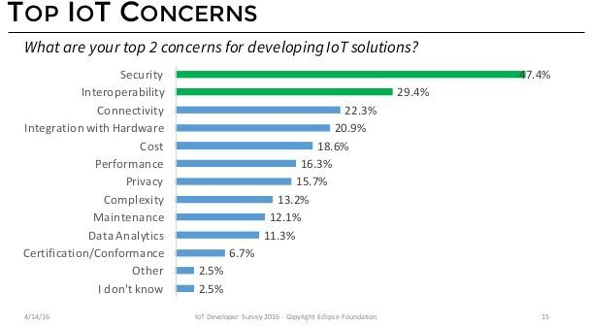
What's the Security Concern with IoT?

Slide 20
What's the Security Concern with IoT?
Although IoT devices may seem too small or too specialized to be dangerous, there is real risk in what are really network-connected, general purpose
computers that can be hijacked by attackers, resulting in
problems beyond IoT security.
Even the most mundane device can become dangerous when compromised over the internet—from spying with video baby monitors to interrupted services on
life-saving health care equipment.
Once attackers have control, they can steal data, disrupt delivery of services, or commit any other cybercrime they'd do with a computer.
Attacks that compromise IoT infrastructure inﬂict
damage, not just with data breaches and unreliable operations, but also physical harm to the facilities, or worse—to the humans operating or relying on those facilities.

Slide 21
Threats of IoT Cybersecurity Attacks
Processes—threats to processes both under your control, such as web services, and threats from external entities, such as users and satellite feeds, that interact with the system, but are not under the control of the application.
Communication, also called data ﬂows—threats around the communication path between devices, devices and ﬁeld gateways, and device and cloud gateway.
Storage—threats to temporary data queues, operating systems (OS), and image storage

Slide 22
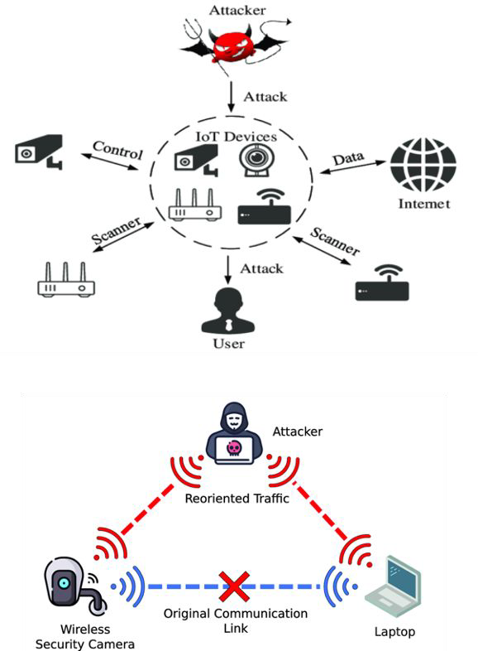
Spooﬁng
An attacker can manipulate the state of a device anonymously.
An attacker may intercept or partially override the broadcast and spoof the originator (often called
man-in-the-middle or MitM attacks).
An attacker can take advantages of the vulnerability of constrained or special-purpose devices. These devices, which often have one-for-all security facilities like password or PIN protection or rely on network shared key protections.
When the shared secret to device or network (PIN, password, shared network key) is disclosed, it is possible to control the device or observe data emitted from the device.

Slide 23
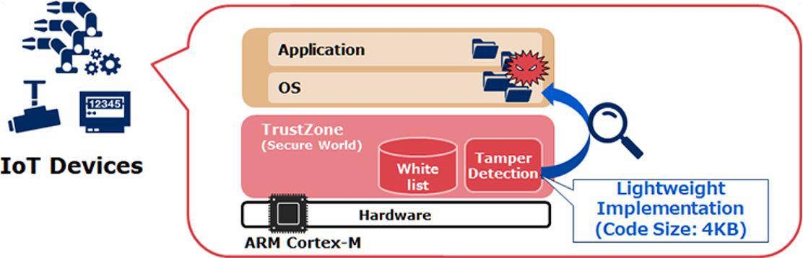
Tampering
An attacker can tamper with any physical device—from battery drainage vulnerability or “sleep deprivation to random number generator (RNG) attacks made possible by freezing devices to reduce entropy.
An attacker may partially or wholly replace the software running on the device, potentially allowing the replaced software to leverage the genuine identity of the device if the key material or the cryptographic facilities holding key materials were available to the illicit program.

Slide 24
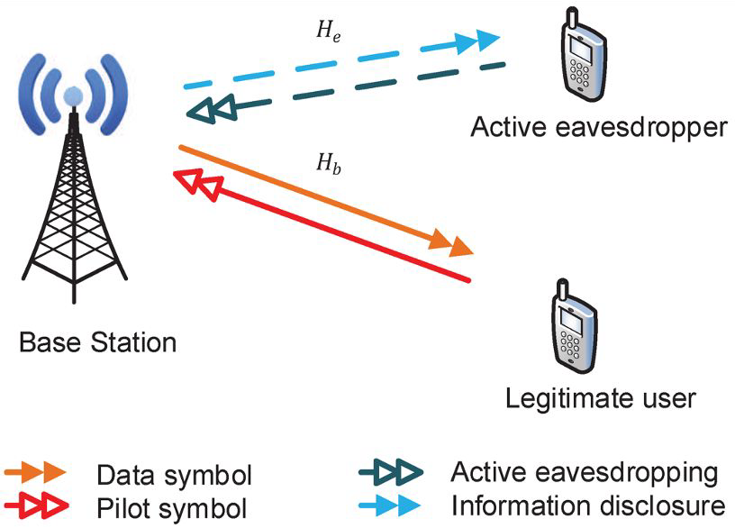
Eavesdrop
An attacker may eavesdrop on a broadcast and obtain information without authorization or may jam the broadcast signal and deny information distribution.
An attacker may intercept or partially override the broadcast and send false information.

Slide 25
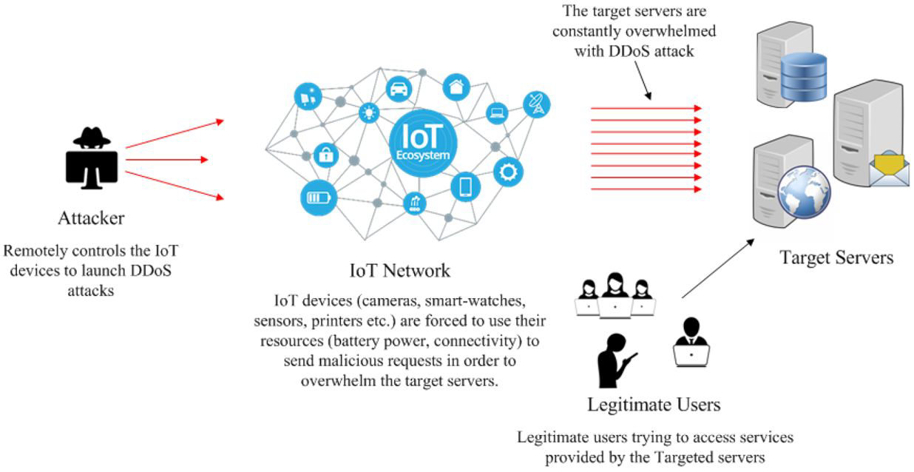
Denial of Service
A device can be rendered incapable of functioning or communicating by interfering with radio frequencies or cutting wires.
For example, a surveillance camera that had its power or network connection intentionally knocked out cannot report data, at all.

Slide 26
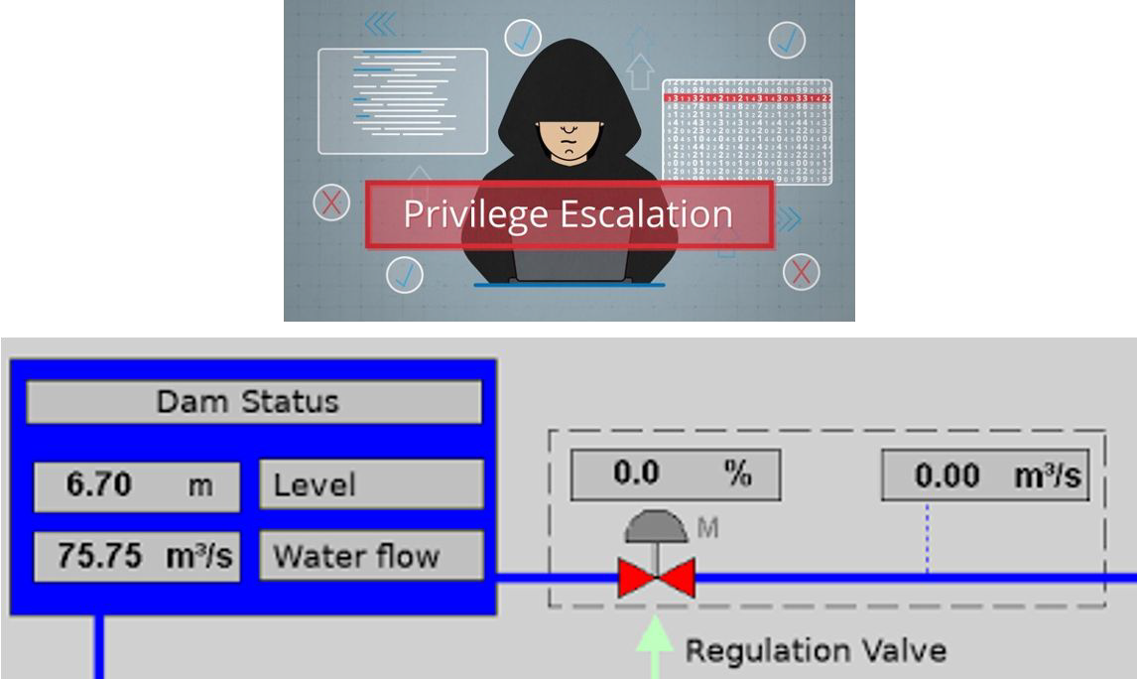
Elevation of Privilege
A device that does speciﬁc function can be forced to do something else.
For example, a valve that is programmed to open halfway can be tricked to open all the way.

Slide 27
What Steps Can I Take to Secure IoT Deployments?
Simplify security for IoT complexity
keep it simple
Integrate across teams and infrastructure to coordinate a comprehensive approach, from the physical devices and sensors to your data in the cloud.
Prepare for IoT security speciﬁcally
Consider resource-constrained devices, geographic distribution of deployments, and the number of devices within an IoT security solution.
Get smart about security analytics and remediation
Monitor everything connected to your IoT solution with security posture management. Stack rank the suggestions based on severity to decide what to ﬁx ﬁrst to reduce your risk. Make sure to have threat monitoring in place to get alerts and address IoT security threats quickly.
Focus on customer and business data protection
By tracking all your connected data stores, admins, and other services that touch IoT, you can make sure your IoT apps are protected and your security for IoT is effective.
Plan for attack routine

Slide 28
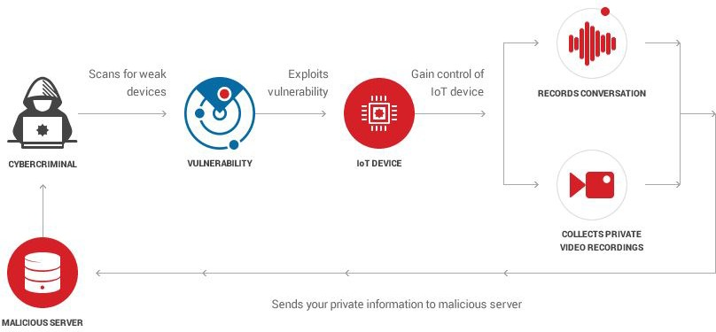
How to Secure IoT Devices in the Enterprise?
Employ Device Discovery for Complete Visibility.
Apply Network Segmentation for Stronger Defense.
Adopt Secure Password Practices.
Continue to Patch and Update Firmware When Available.
Actively Monitor IoT Devices at All Times.

